Slide 1

Components of Power BI & Query Editor Akriti Lal

Slide 2
Power BI Model Based Tool

Slide 3
Pros & Cons of Model based Tool LIKE Power BI Vs report-based tool like tableau
Model Based Tool : Once defined, the same model can be used for different reports.
Report Based Tool : Simple to use, calculations are scoped to a single report only.
PROS
Model Based Tool : A good model that works with many different reports requires more authoring time.
Report Based Tool : Requires specific data transformation for every report.
These assumes that the input is made by a single table, or something that can be transformed into a single table.
CONS

Slide 4
Power BI – Flow For Best Understanding

Slide 5

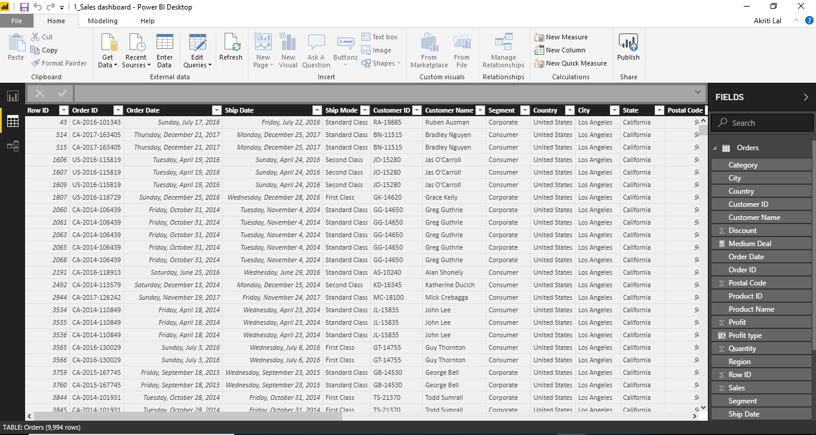

Power BI Flow – For Best Understanding
1. Data : To Connect, Shape and Transform raw data

Slide 6


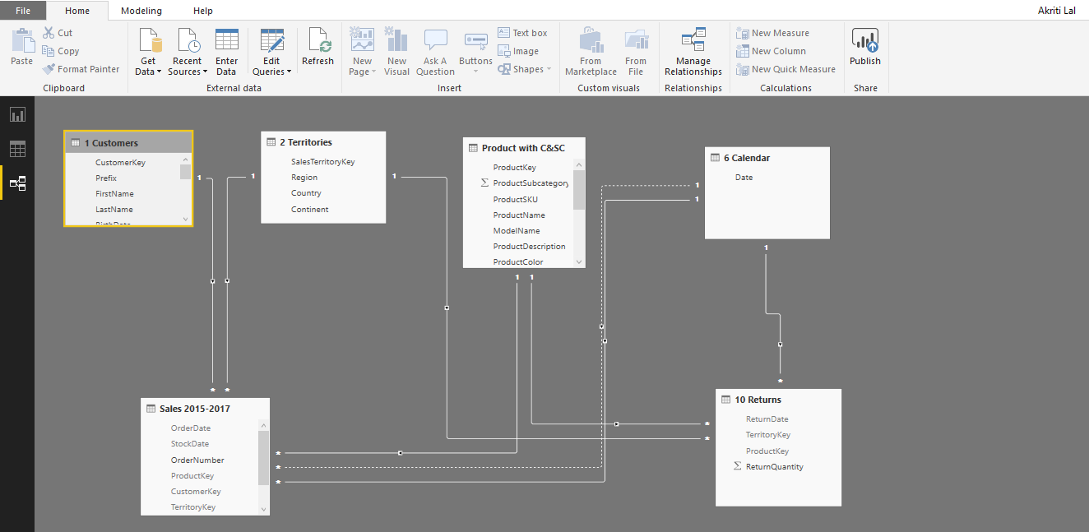
Power BI Flow – For Best Understanding
2.Relationships/Model : Build Table Relationship to tie them together

Slide 7
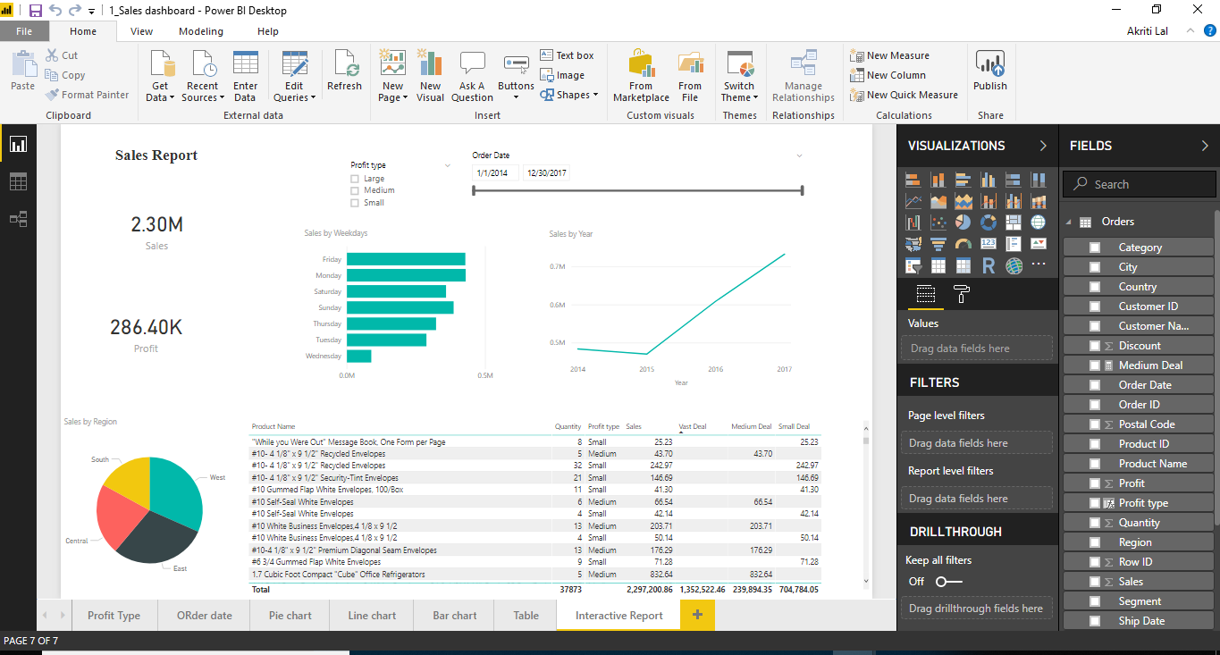
Power BI Flow – For Best Understanding
3 Report : Design interactive reports to explore and visualize data

Slide 8







Power BI Flow – Summary – For Best Understanding
1. Data : To Connect, Shape and Transform raw data
2.Relationships : Build Table Relationship to tie them together
3 Report : Design interactive reports to explore and visualize data

Slide 9
Power BI – Before we Start - Settings

Slide 10
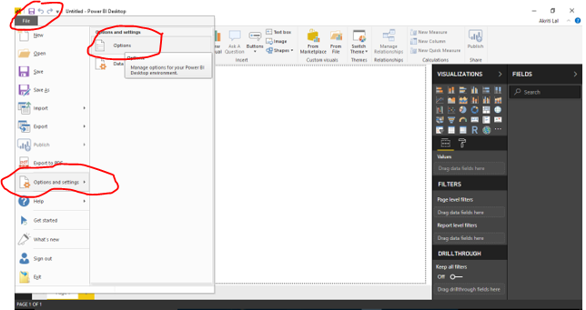
Before we start , For Better Understanding Set some Options & Settings for Power BI Desktop During the Course . Click on Options as shown below and check the 3 changes

Slide 11
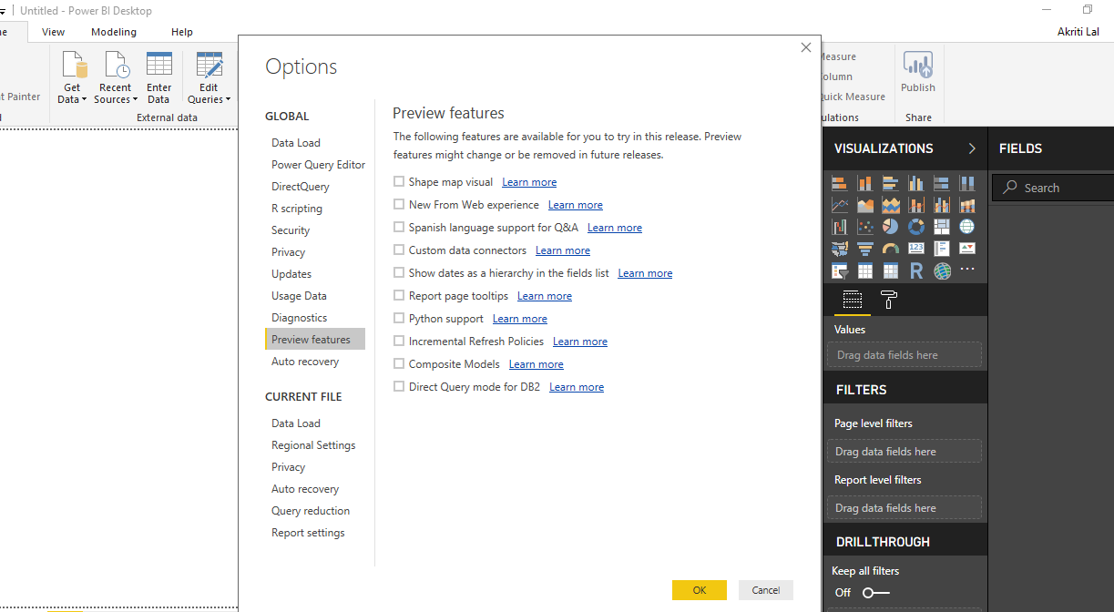
1. Power BI Options & Settings
In the “Preview Features” tab, deselect any active Preview features while you are taking the course

Slide 12
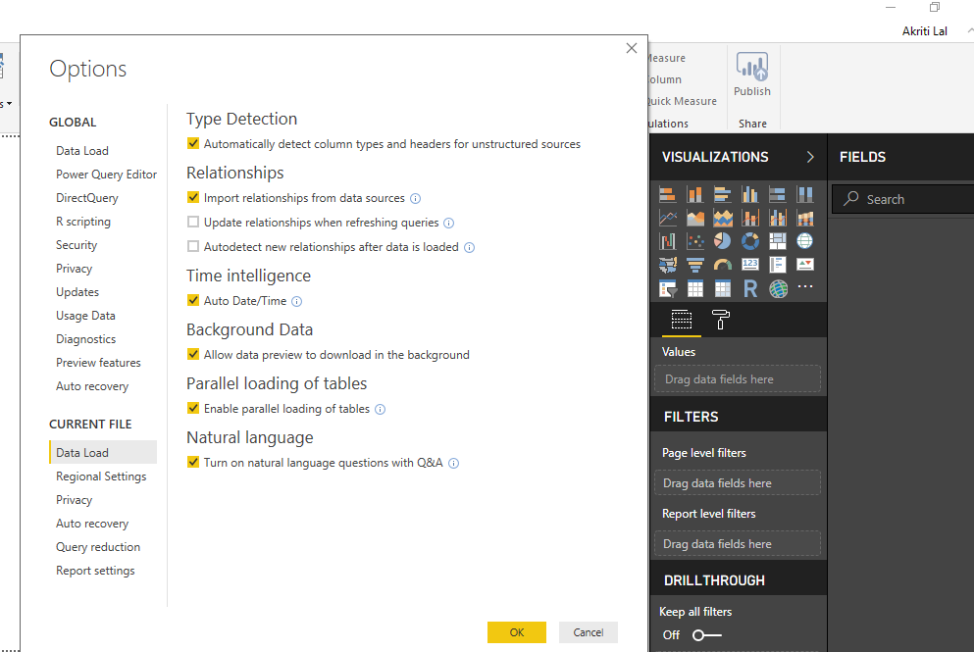
2. Power BI Options & Settings
In the “Data Load” tab, Uncheck the “Update relationships” and “Autodetect new relationships after data is loaded” options

Slide 13
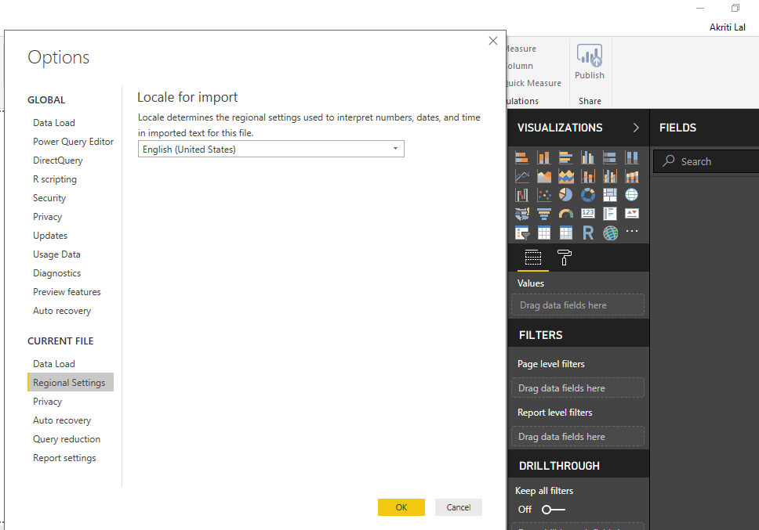
3. Power BI Options & Settings
In the “Regional Settings” tab, make sure to use the “English (United States)” locale for import

Slide 14
Power BI – Data Discovery : Connecting & Shaping Data

Slide 15
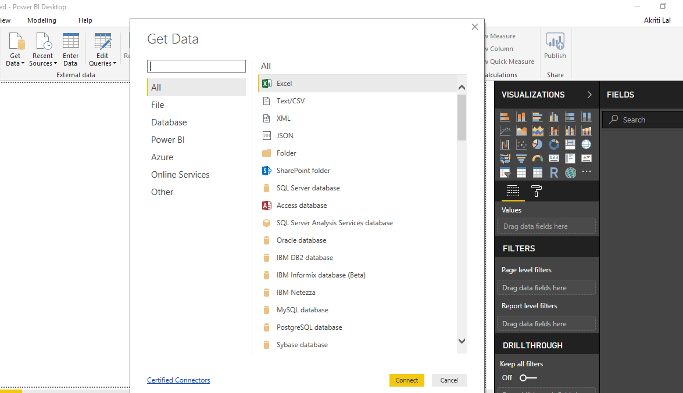
TYPES OF DATA CONNECTORS
Power BI can connect to virtually any type of source data, including (but not limited to):
Flat files & Folders (csv, text, xls, json) , Databases (SQL Server, Access, Oracle, IBM, Azure, etc) , Online Services (Sharepoint, GitHub, Dynamics 365, Google Analytics, Salesforce, Power BI Service, , Others (Web feeds, R scripts, Spark, Hadoop, etc)

Slide 16

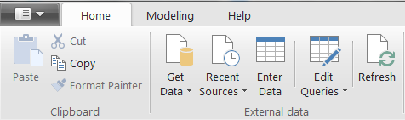


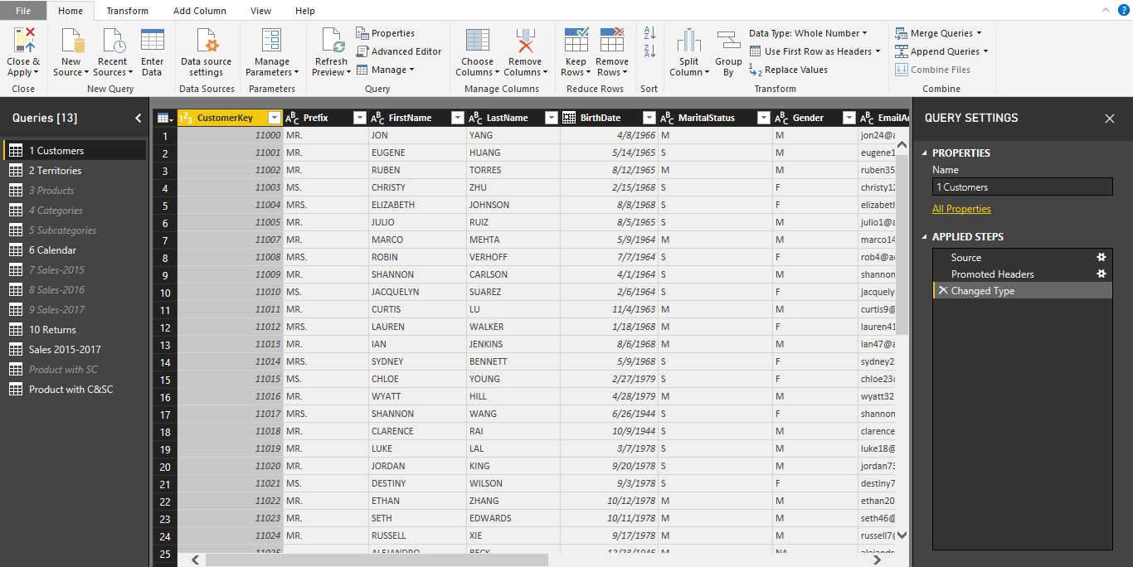

THE QUERY EDITOR
Query Editing Tools (Table transformations, calculated columns, etc)
Table Name
& Properties
Query
Applied Steps
(

Slide 17

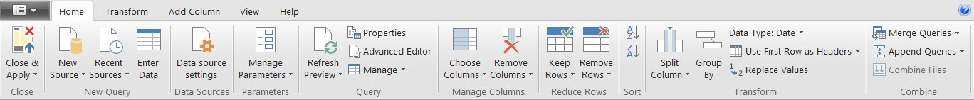
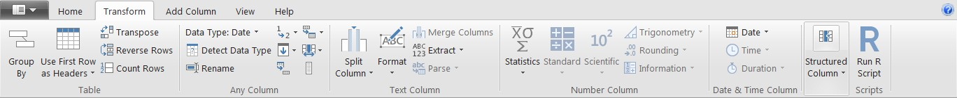
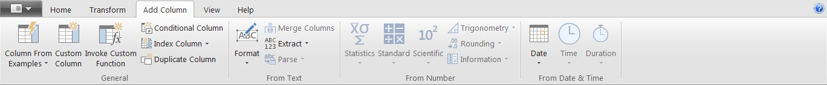
QUERY EDITING TOOLS
The HOME tab includes general settings and common table transformation tools
The TRANSFORM tab includes tools to modify existing columns (splitting/grouping, transposing, extracting text, etc)
The ADD COLUMN tools create new columns (based on conditional rules, text operations, calculations, dates, etc)

Slide 18


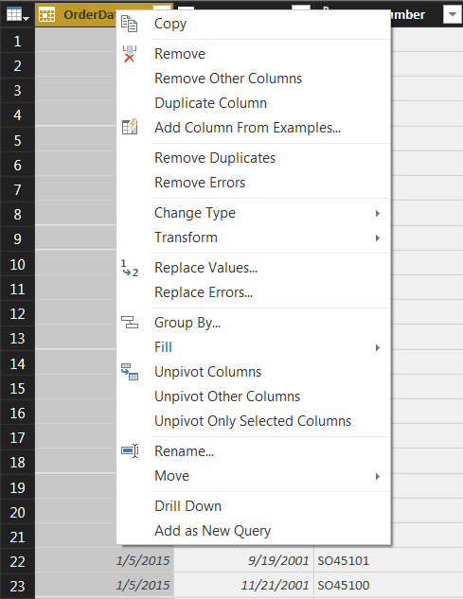




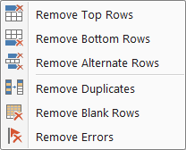
BASIC TABLE TRANSFORMATIONS
Sort values (A-Z, Low-High, etc.)
Change data type (date, $, %, text, etc.)
Promote header row
Duplicate, move &
rename columns
Choose or remove columns
Tip: use the “Remove Other Columns” option if you always want a specific set
Tip: Right-click the column header to access common tools
Keep or remove rows
Tip: use the “Remove Duplicates” option to create a new lookup table from scratch

Slide 19


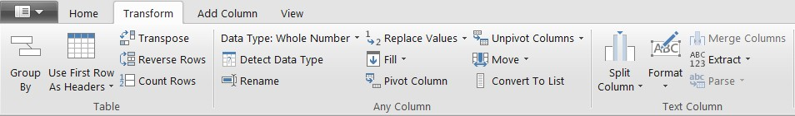
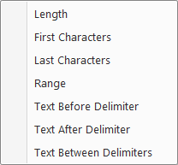




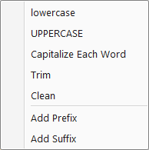
TEXT-SPECIFIC TOOLS
Extract characters from a text column based on fixed lengths, first/last, ranges or delimiters
Split a text column based on either a specific delimiter or a number of characters
Tip: Select two or more columns to
merge (or concatenate) fields
Format a text column to upper, lower or proper case, or add a prefix or suffix
Tip: Use “Trim” to eliminate leading & trailing spaces, or “Clean” to remove non-printable characters

Slide 20

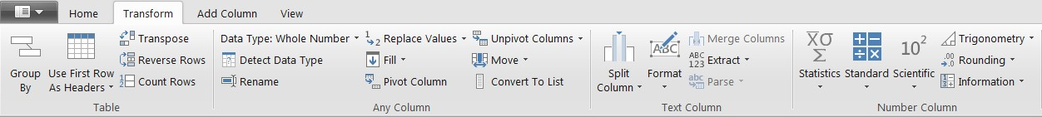


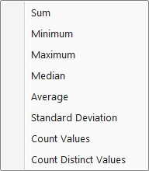

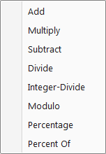




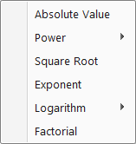
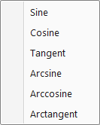
NUMBER-SPECIFIC TOOLS
Information tools allow you to define binary flags (TRUE/FALSE or 1/0) to mark each row in a column as even, odd, positive or negative
Statistics functions allow you to evaluate basic stats for the selected column (sum, min/max, average, count, countdistinct, etc)
Standard Scientific Trigonometry
Standard, Scientific and Trigonometry tools allow you to apply standard operations (addition, multiplication, division, etc.) or more advanced calculations (power, logarithm, sine, tangent, etc) to each value in a column
Note: These tools return a SINGLE value, and are commonly used to explore a table rather than prepare it for loading
Note: Unlike the Statistics options, these tools are applied to each individual row in the table

Slide 21

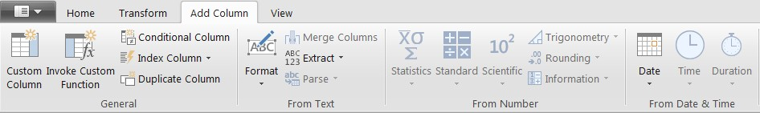


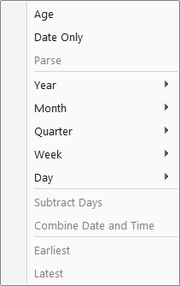
DATE-SPECIFIC TOOLS
Date & Time tools are relatively straight-forward, and include the following options:
Age: Difference between the current time and the date in each row
Date Only: Removes the time component of a date/time field
Year/Month/Quarter/Week/Day: Extracts individual components from a date field (Time-specific options include Hour, Minute, Second, etc.)
Earliest/Latest: Evaluates the earliest or latest date from a column as a single value (can
only be accessed from the “Transform” menu)

Slide 22

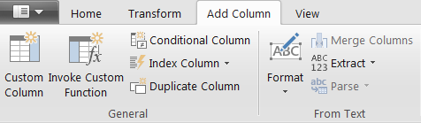


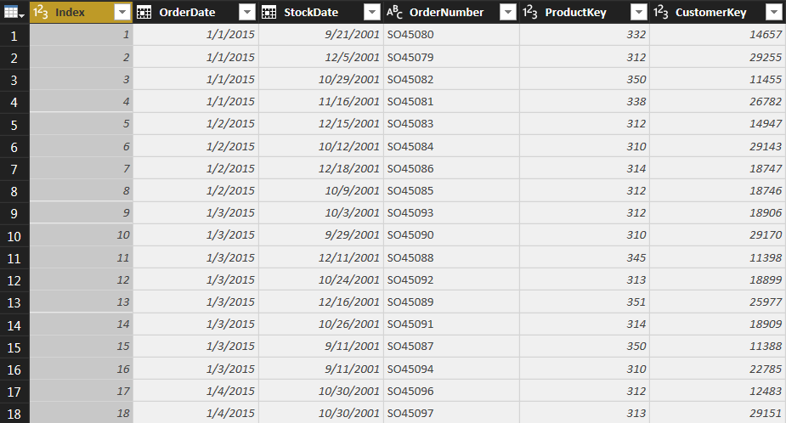
ADDING INDEX COLUMNS
Index Columns contain a list of sequential values that can be used to identify each unique row in a table (typically starting from 0 or 1)
These columns are often used to create unique IDs that can be used to form relationships between tables (more on that later!)

Slide 23


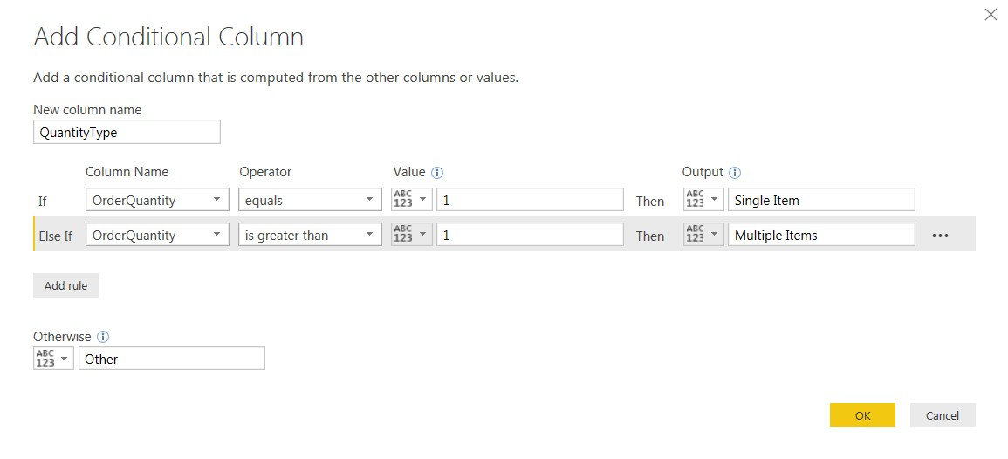
ADDING CONDITIONAL COLUMNS
Conditional Columns allow you to define new fields based on logical rules and conditions (IF/THEN statements)
In this case we’re creating a new conditional column called “QuantityType”, which depends on the values in the “OrderQuantity” column, as follows:
If OrderQuantity =1, QuantityType = “Single Item”
If OrderQuantity >1, QuantityType = “Multiple Items”
Otherwise QuantityType = “Other”

Slide 24

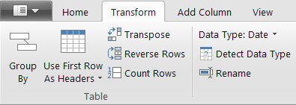




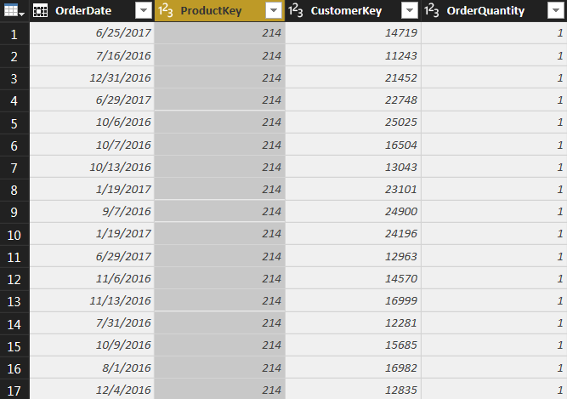
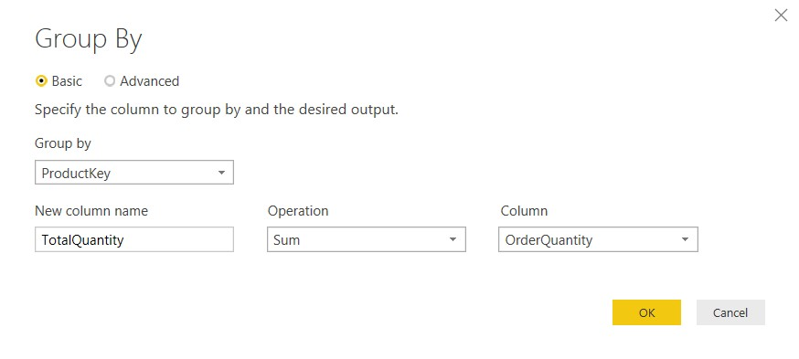
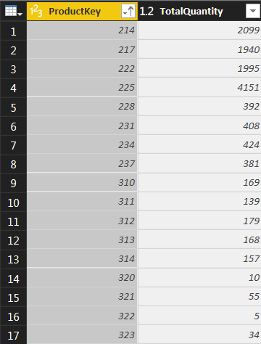


GROUPING & AGGREGATING DATA
Group By allows you to aggregate your data at a different level
(i.e. transform daily data into monthly, roll up transaction-level data by store, etc)
In this case we’re transforming a daily, transaction-level table into a
summary of “TotalQuantity” rolled up by “ProductKey”
NOTE: Any fields not specified in the Group By settings are lost

Slide 25

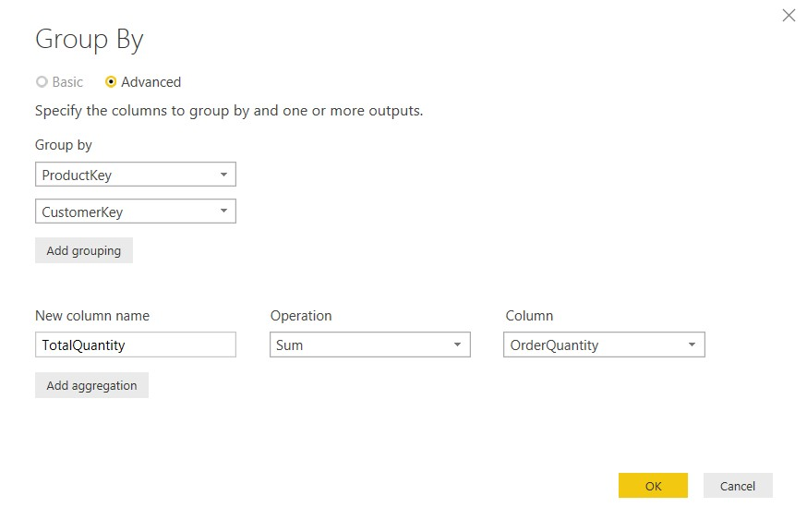

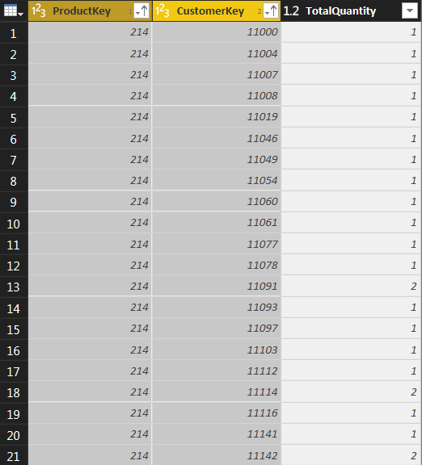


GROUPING & AGGREGATING DATA (ADVANCED)
This time we’re transforming the daily, transaction-level table into a summary of “TotalQuantity” aggregated by both “ProductKey” and “CustomerKey” (using the advanced option in the dialog box)
NOTE: This is similar to creating a PivotTable in Excel and pulling in “Sum of OrderQuantity” with ProductKey and CustomerKey as row labels

Slide 26


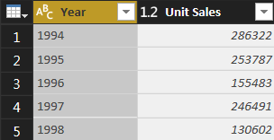
PIVOTING & UNPIVOTING
“Pivoting” is a fancy way to describe the process of turning distinct row values into columns (“pivoting”) or turning columns into rows (“unpivoting”)
Imagine that the table is on a hinge; pivoting is like rotating it from a vertical to a horizontal layout, and unpivoting is like rotating it from horizontal to vertical
NOTE: Transpose works very similarly, but doesn’t recognize unique values; instead, the entire table is transformed so that each row becomes a column and vice versa

Slide 27

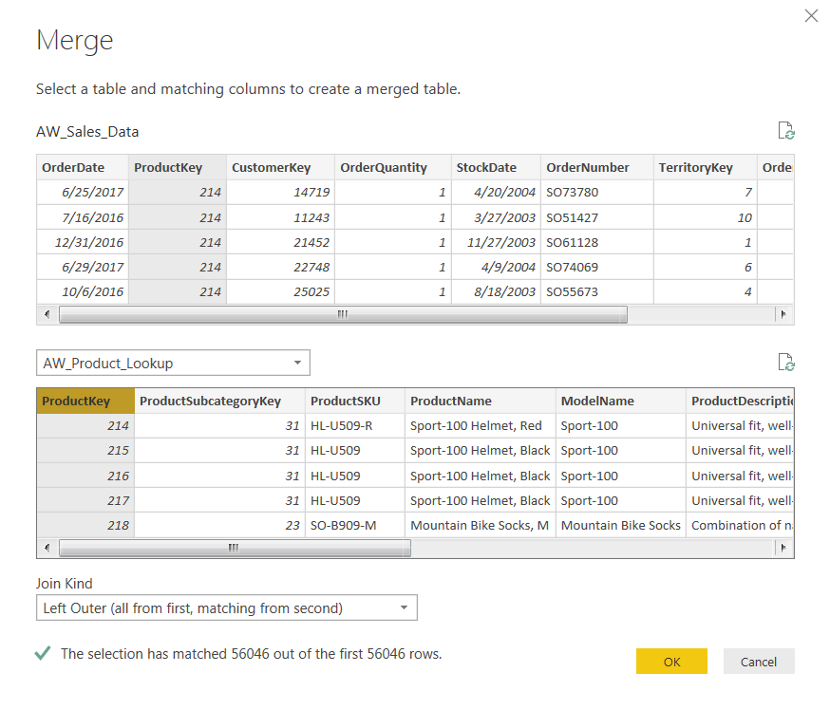

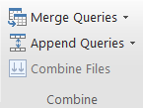

MERGING QUERIES
Merging queries allows you to join tables based on a common column (like VLOOKUP)
In this case we’re merging the AW_Sales_Data table with the AW_Product_Lookup table, which share a common “ProductKey” column
NOTE: Merging adds columns to an existing table

Slide 28


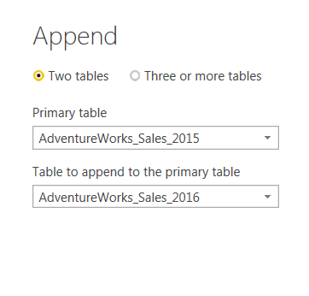
APPENDING QUERIES
Appending queries allows you to combine (or stack) tables that share the exact same column structure and data types
In this case we’re appending the AdventureWorks_Sales_2015 table to the AdventureWorks_Sales_2016 table, which is valid since they share identical table structures
NOTE: Appending adds rows to an existing table

Slide 29


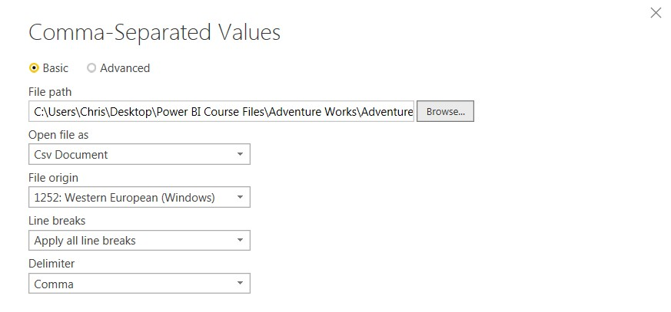
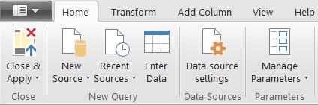


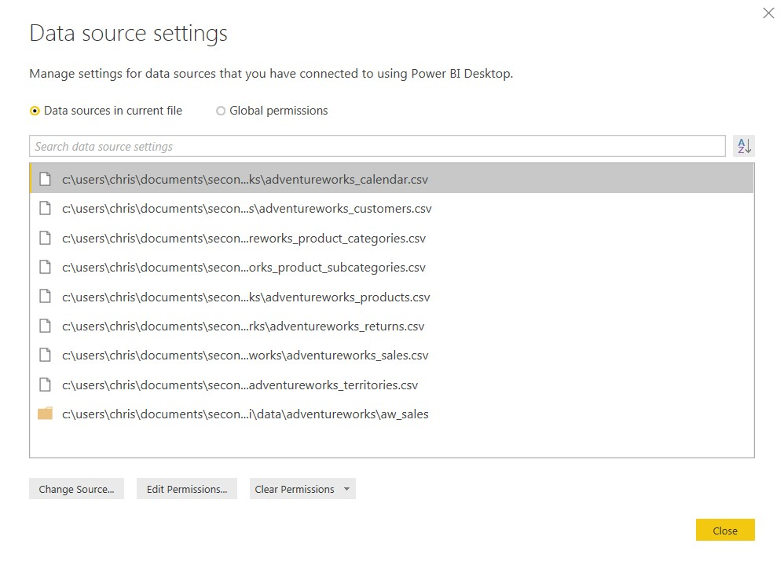

DATA SOURCE SETTINGS
The Data Source Settings in the Query Editor allow you to manage data connections and permissions
HEY THIS IS IMPORTANT!
Connections to local files reference the exact path
If the file name or location changes, you will need to change the source and browse to the current version

Slide 30

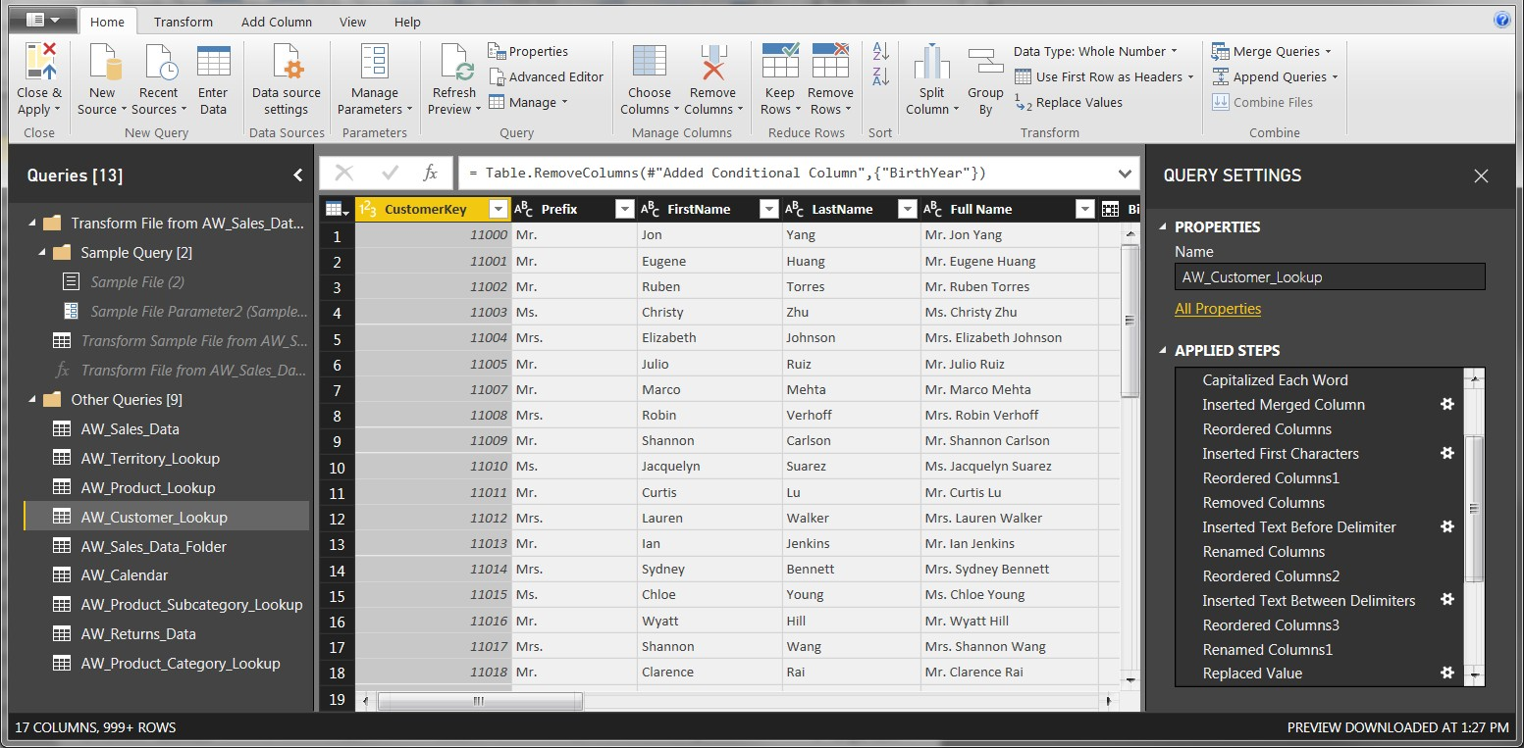


MODIFYING QUERIES
Select “Edit Queries” from the Home tab to launch the Query Editor
Within the editor, view or modify existing queries in the “Queries” pane
Within each query, you can click each item within the “Applied Steps” pane to view each stage of the transformation, add new steps or delete existing ones, or modify individual steps by clicking the gear icons

Slide 31


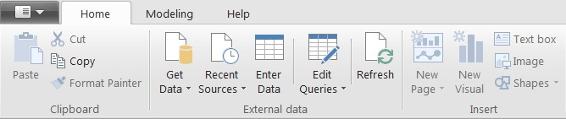
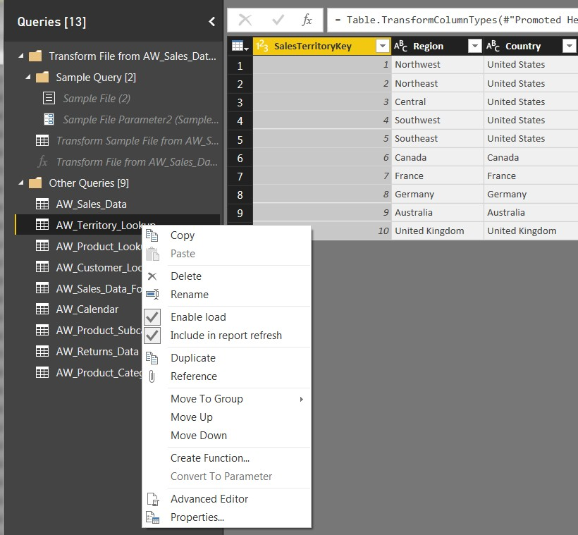

REFRESHING QUERIES
By default, ALL queries in the model will refresh when
you use the “Refresh” command from the Home tab
From the Query Editor, uncheck “Include in report refresh” to exclude individual queries from the refresh

Slide 32

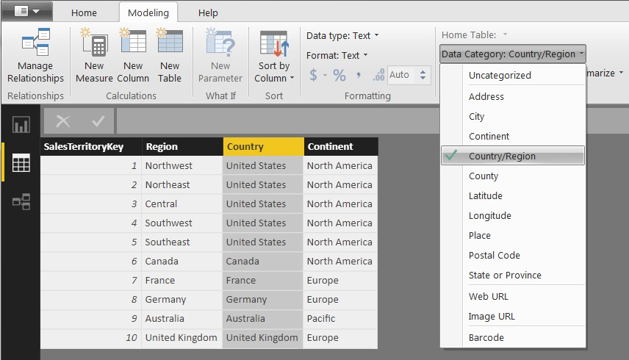


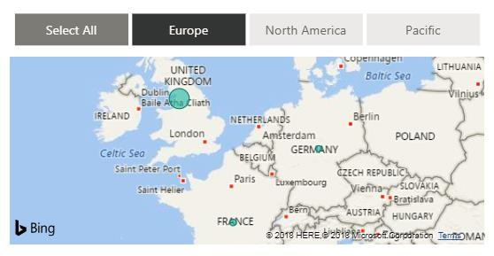
DEFINING DATA CATEGORIES
From the “Modeling” tab in the Data view, you can edit field properties to define specific categories
This is commonly used to help Power BI accurately map location-based fields like addresses, countries, cities, latitude/longitude coordinates, zip codes, etc

Slide 33



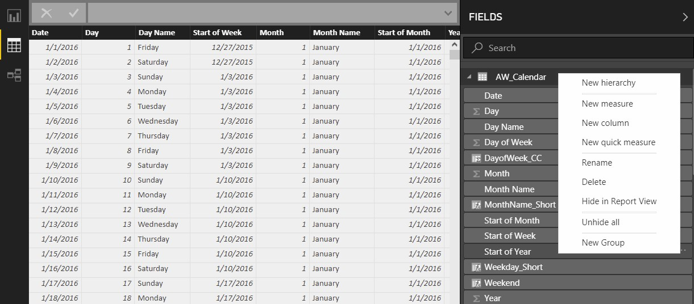
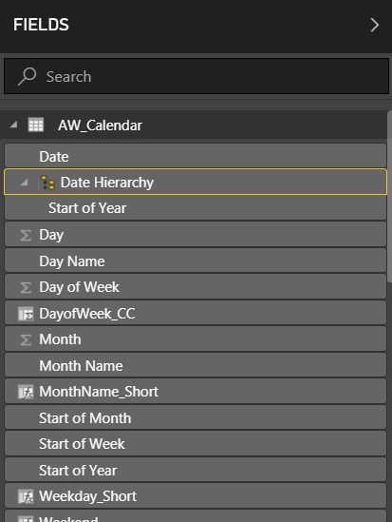
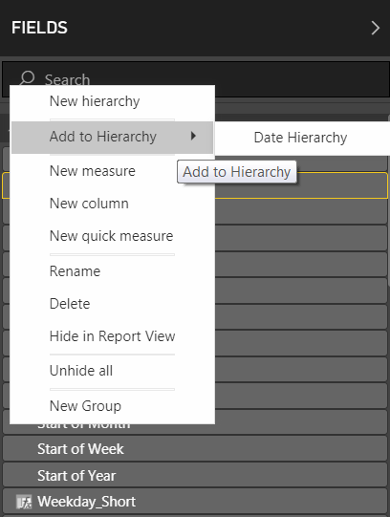
DEFINING HIERARCHIES
Hierarchies are groups of nested columns that reflect multiple levels of granularity
For example, a “Geography” hierarchy might include Country, State, and City columns
Each hierarchy can be treated as a single item in tables and reports, allowing users to “drill up” and “drill down” through different levels of the hierarchy in a meaningful way
1) From within the Data view, right-click a field (or click the ellipsis) and select “New hierarchy” (here we’ve selected “Start of Year”)
2) This creates a hierarchy field containing “Start of Year”, which we’ve renamed “Date Hierarchy”
3) Right-click other fields (like “Start of Month”) and select “Add to Hierarchy”

Slide 34


BEST PRACTICES: CONNECTING & SHAPING DATA
Get yourself organized, before loading the data into Power BI
Define clear and intuitive table names (no spaces!) from the start; updating them later can be a headache, especially if you’ve referenced them in multiple places
Establish a file/folder structure that makes sense from the start, to avoid having to modify data source settings if file names or locations change
Disabling report refresh for any static sources
There’s no need to constantly refresh sources that don’t update frequently (or at all), like
lookups or static data tables; only enable refresh for tables that will be changing
When working with large tables, only load the data you need
Don’t include hourly data when you only need daily, or product-level transactions when you only care about store-level performance; extra data will only slow you down

Slide 35
Exercise :
In the Customers table
Capitalize Prefix, First Name & Last Name Column
Create a column called “Full Name”
Create a new column named "birth_year" to extract the year from the "birthdate" column, and format as text
Create a conditional column named “Parent" which equals "N" if "total_children" = 0, otherwise "Y"

Slide 36
Exercise :
In the Customer table do the following :
Add a new column User name from Email Address column
Add a new column Domain name from Email Address
Format the Domain name column to remove the (-) in the middle of the words and replace it with a space.
Capitalize the words in the Domain name column

Slide 37
Exercise :
In Products table :
Use the statistics tools to return the number of distinct product names,
Quick check: You should see 293 unique Products
Check the average price of the Products Price.
Quick check: You should see 714.43 as avg. price
Round the Product Cost & Product Price to 2 decimal places.

Slide 38
Exercise :
In Products table :
Return 90% of the Product price as a new column through Standard function and call it Discounted Price rounding to 2 decimal place.
Format the Product Cost, Product Cost and Discount columns as $ for Data (Modelling) tab.

Slide 39


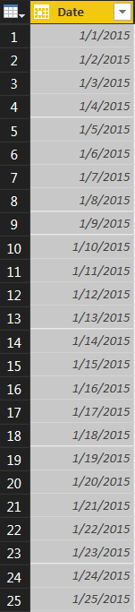







CREATING A BASIC CALENDAR TABLE
Use pre-defined Date options in the “Add Column” menu to quickly build out a calendar table from a list of dates

Slide 40
Exercise :
In the Calendar table add the following:
Check the Earliest (1/1/2015 )and the Latest Date (6/30/2017 )
Day of the Week
Day Name
Start of the Week
Month
Quarter
Year
Format the Date from the Data tab to MM/DD/YYYY

Slide 41
Exercise :
Bring Sales 2015, Sales 2016 and Sales 2017 tables to Power BI and append all the 3 tables to form Fact_Sales- 2015- 17 table.
Format the Order Date & Stock Date Column from the Data tab (Modelling) to MM/DD/YYYY

Slide 42
Exercise :
Bring Territories table to Power BI and do the following:
From the Data (Modeling) tab categories the Country and the Continent column as geographic location.
Quick check : You will see a globe sign next to the column names in the Fields pane.

Slide 43
Exercise :
Bring all The other tables i,e, Returns, Product Sub Category, Product Category and finish the data modelling.

